Slide 1
Getting the lead out. Guelph’s journey from paper to online for Course Evaluations.
Lucia Costanzo and Peter McCaskell
Computing and Communications Services University of Guelph

Slide 2
Course Evaluations Things we have in common – the good
1. Opportunity for students to provide their feedback on the course, instructor, textbook, TA, etc.
2. Input for Tenure and Promotion
3. Fuel the upward spiral of continuous improvement
1

Slide 3
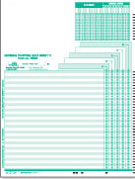
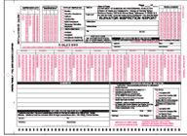
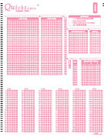
Course Evaluations Things we have in common – the bad
1. Labour intensive
2. Paper intensive
2

Slide 4
Course Evaluations Things we have in common – the bad
1. Labour intensive
2. Paper intensive
150,000 in 2004
3

Slide 5
Course Evaluations Things we have in common – the bad
1. Labour intensive
2. Paper intensive
3. Response quality when conducted at the end of the last class of the semester.
4

Slide 6
In 2004, we introduced a system for online evaluations
Froze our support for paper forms
Incrementally rolled out a rich-featured online (web) system
Course Management System wasn’t up to the task, so we developed CEVAL with open source components.
5

Slide 7
The two key I.T. enablers …
1. Identity Management System – What courses a student is enrolled in - Information about a course
2. Mail-Merge approach - Master Template surveys - Spreadsheet
6

Slide 8
The two key I.T. enablers …
2. Mail-Merge approach. Master Template surveys Spreadsheet
This is the evaluation for {courseName} {instrLast}
1. This course met my expectations …
7

Slide 9
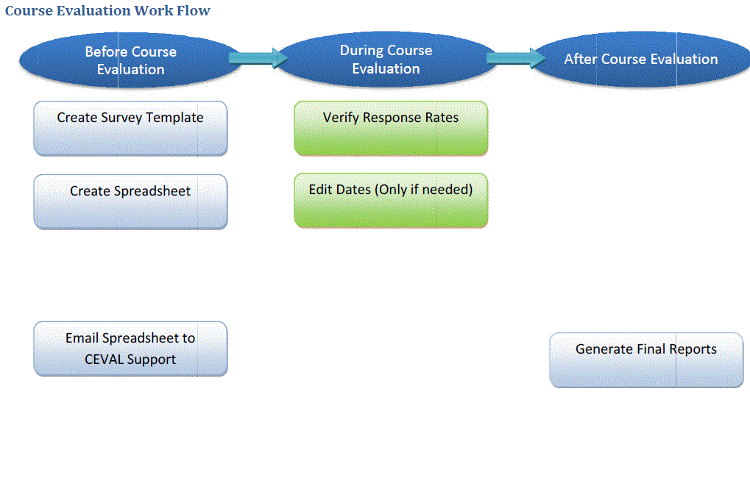
CEVAL: What the departments do:
8

Slide 10
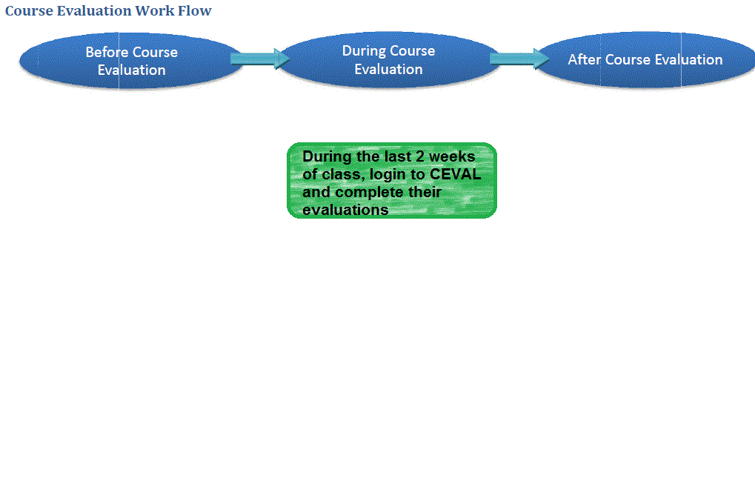
CEVAL: What the students do:
9

Slide 11
What we found out …
Department admins LIKED CEVAL !
Major reduction in resource requirements
More granularity in what they can evaluate
Better tools (e.g. written responses captured)
Faculty – not so much.
Low response rates
Fear of Pub Night effect
Could opt out of online
10

Slide 12
What we found out …
Department admins LIKED CEVAL !
Major reduction in resource requirements
More granularity in what they can evaluate
Better tools (e.g. written responses captured)
Faculty – not so much.
Low response rates
Fear of Pub Night effect
Could opt out of online
11

Slide 13
To increase comfort level amongst faculty …
For response rates:
Incentives for students – since stopped
Publicity directed to students
Targeted emails during the evaluation period
Looked for cheerleaders: Partnered with the Central Students Association
For fear of Pub Night effect:
Provided Deans / Chairs with ratings by time interval – showed no relationship between when a response was submitted and the instructor’s rating.
Looked for cheerleaders amongst the faculty
(Would love to evaluate the same course online and by paper sometime!)
12

Slide 14
To increase comfort level amongst faculty …
In 2010 added support for paper forms.
(In W2011: 15% of evaluations were done by paper)
13

Slide 15
Directionally …
Continue to support paper forms, but encourage online evaluations.
Potentially leverage our Course Management System (Desire2Learn).
Collaborate with you folks around common solutions and best practices.
Look for ways to increase response rates for online evaluations.
14

Slide 16
Thank you !
Lucia Costanzo and Peter McCaskell
Computing and Communications Services University of Guelph
15

